Slide 1
Art Finder

Slide 2
Aim:
The aim is to create a machine learning model that uses image recognition and computer vision for predicting the different styles of the art from the given set of image dataset that recognizes the patterns on the images and then gives the percentage value to which style it belongs too.

Slide 3
Data processing:
The dataset has around 100,000 images with image-specific metadata, which includes the style of the art image.
To prepare the data, each image is pre-processed and converted into normalised, pixel array of shape 224 x 224 x 3.
Art style image label, is encoded into a range of values between 0 to 9 and later converted into one vector array.

Slide 4
Modelling:
A Convolutional Neural Network was constructed with the help of Keras neural network API with a Tensorflow Backend.
For this model, ResNet50 model with pre-trained weights on the ImageNet dataset is used.
Since this is a pre-trained model, it can be able to detect basic features such as edges and colors.
Using this as base model and its corresponding weights, it was then able to add fully connected layers specific to the image dataset to fine tune ResNet50 and apply its understanding of basic objects to identify features that distinguish different art styles.

Slide 5
Architecture:
Base Model:
ResNet50 trained on ImageNet dataset
Fully Connected Layers:
Flatten
Dense (512 neurons, activation = relu)
Dense (10 classes of art, activation = softmax)
Compiled Model:
Optimizer = stochastic gradient descent (SGD)
Loss = categorical cross-entropy

Slide 6


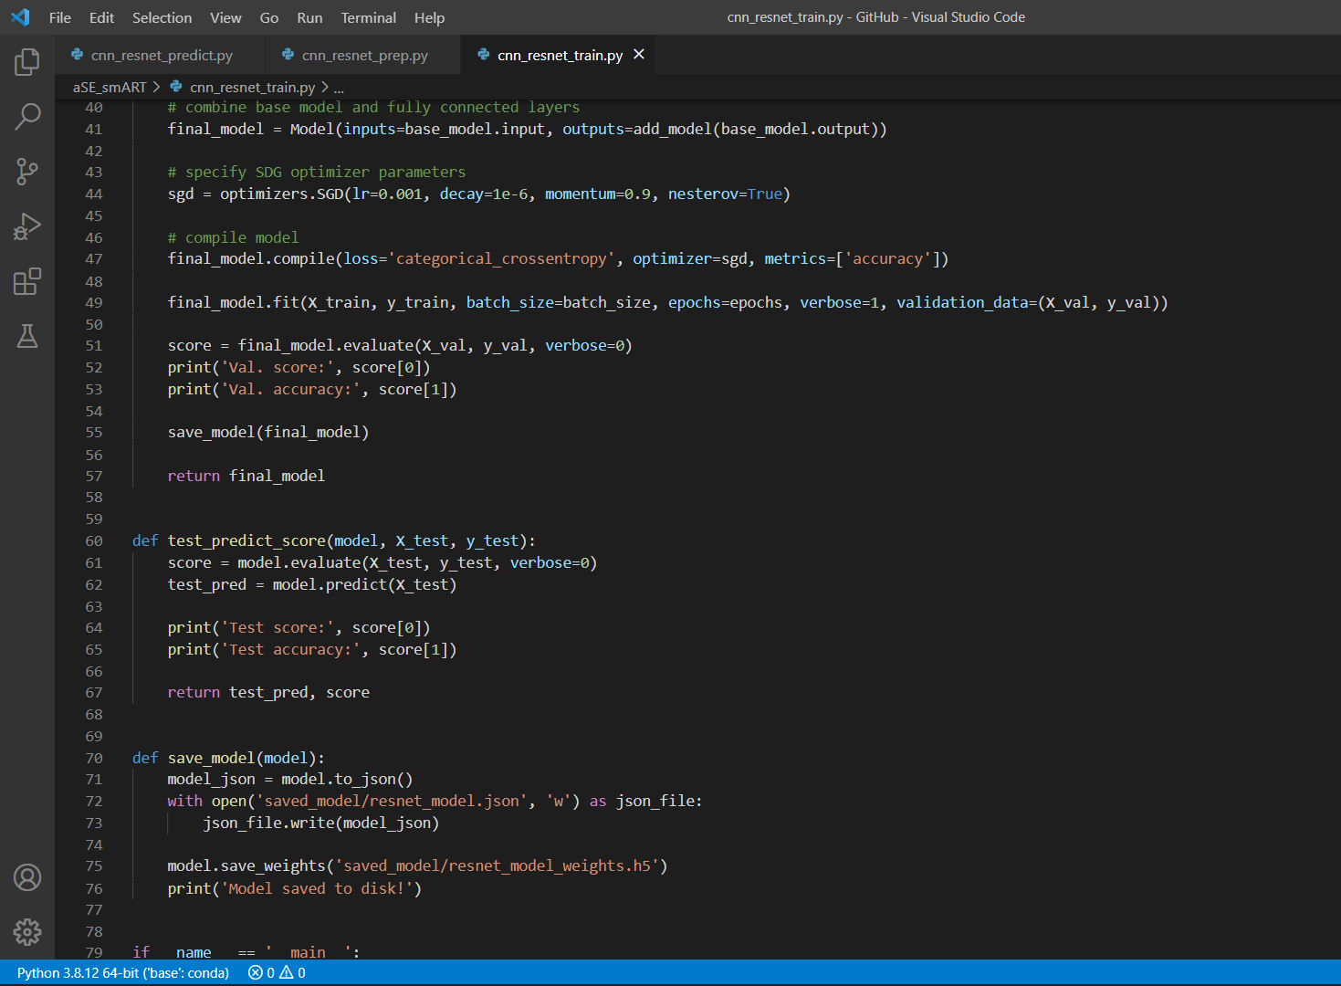
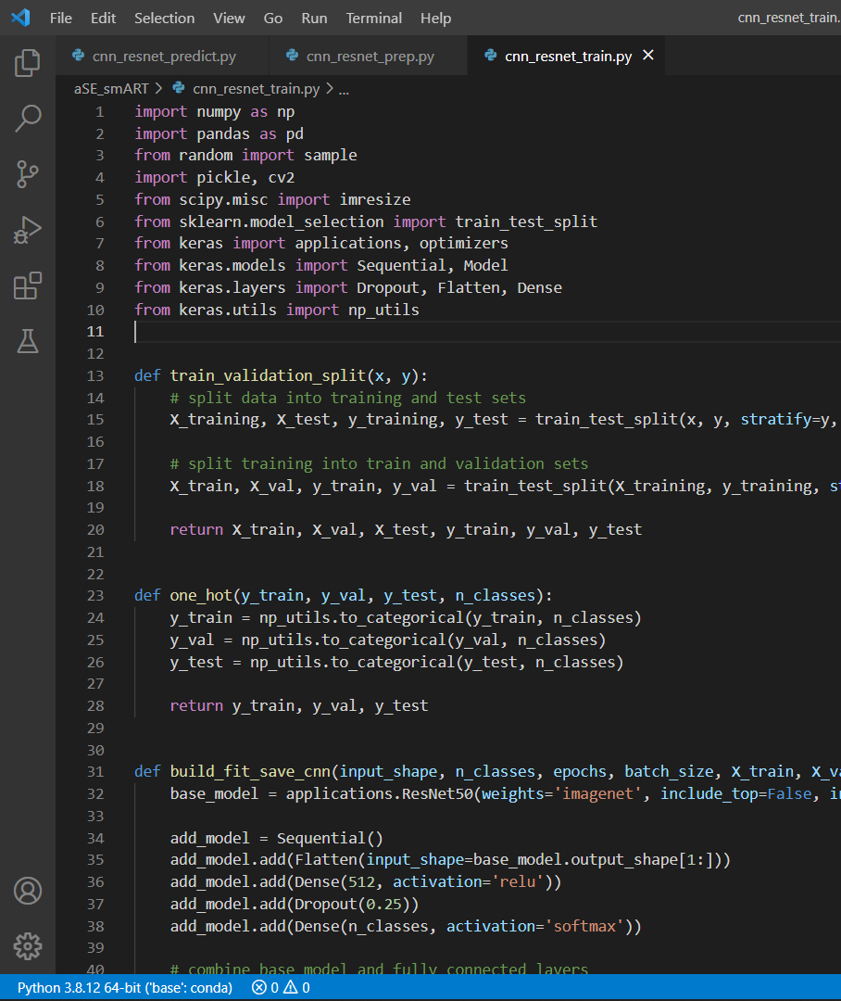
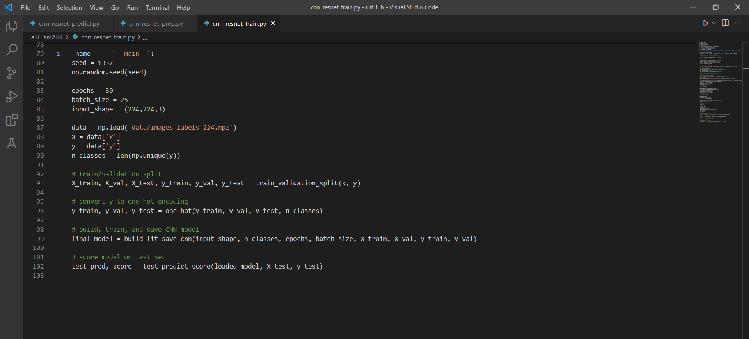
Code:
For Training the model

Slide 7
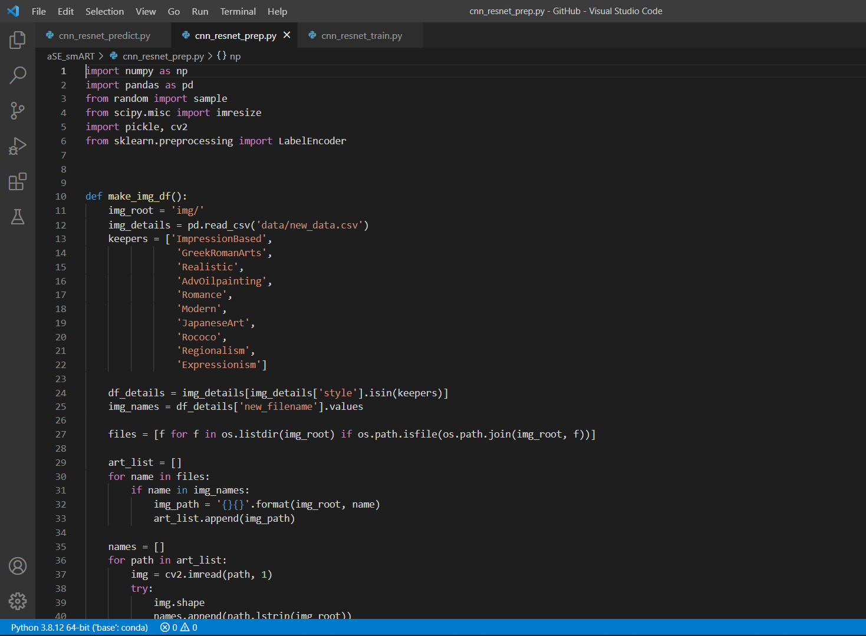
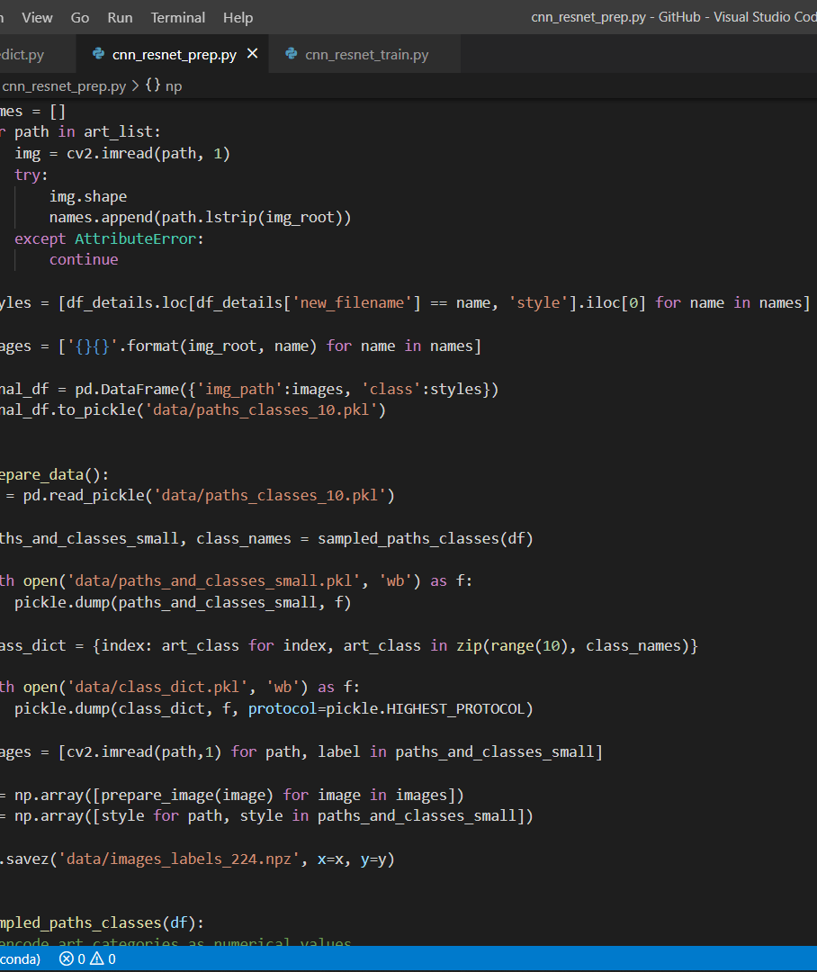
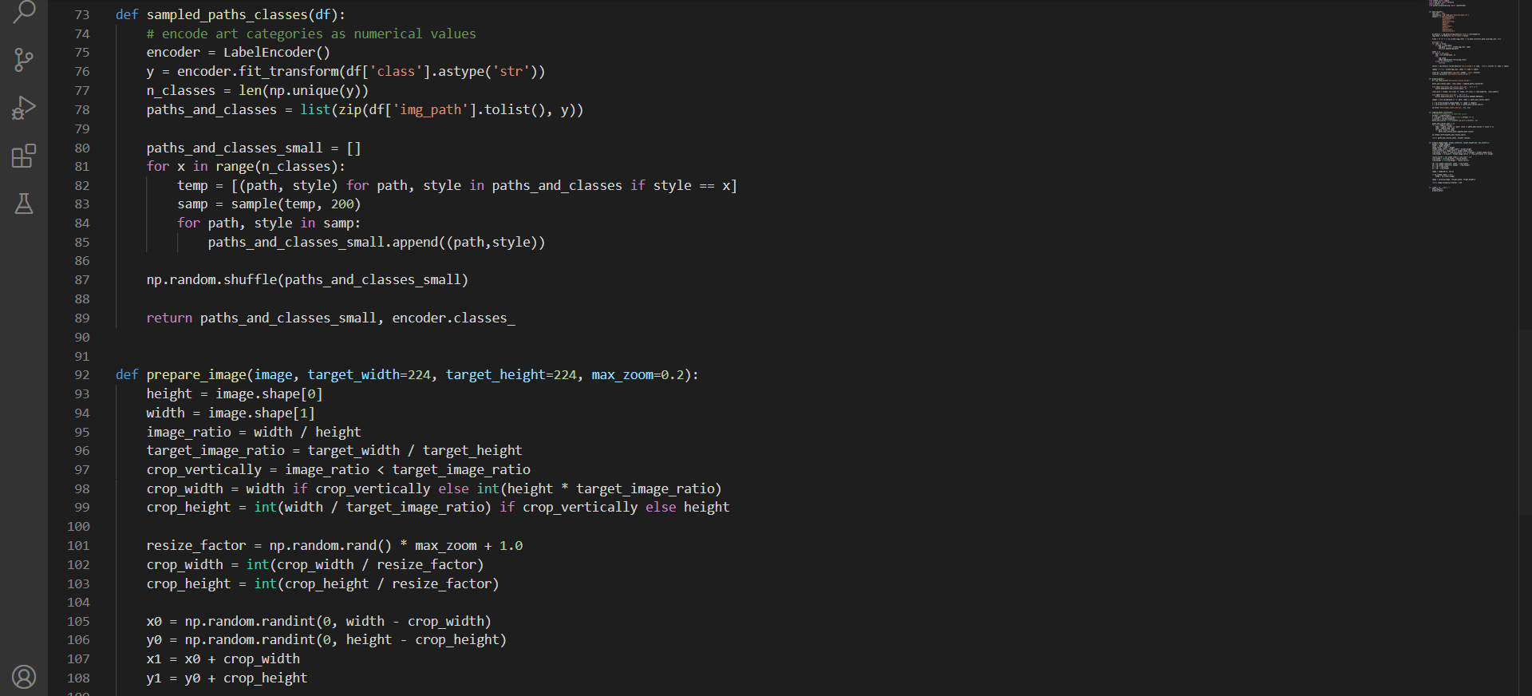
For Preparing the data

Slide 8
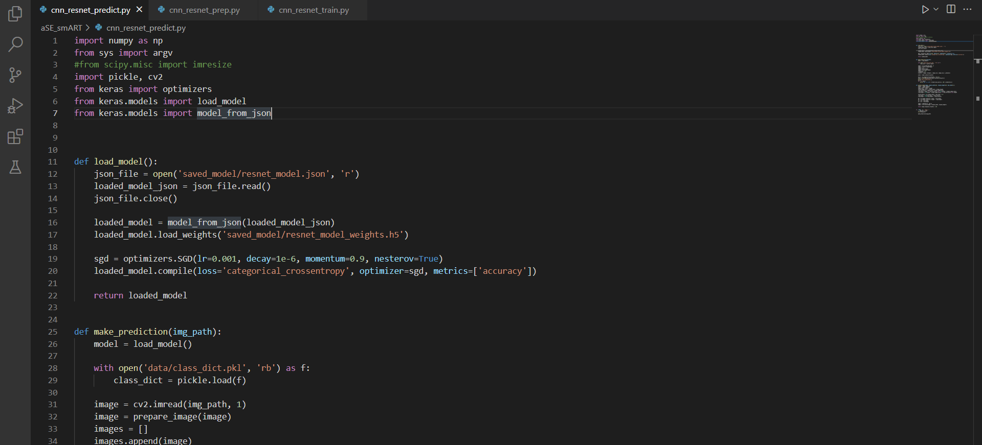
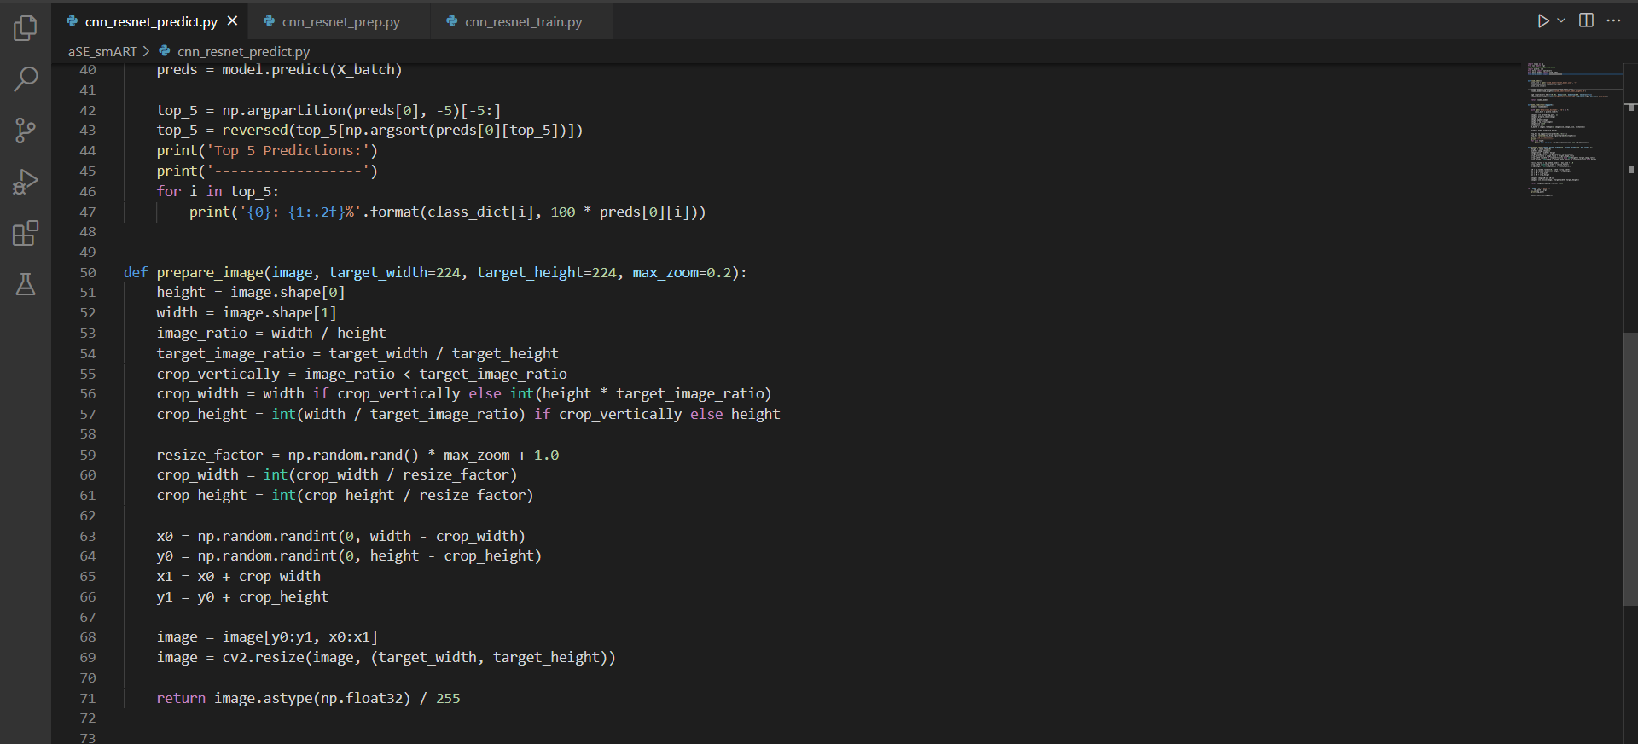
For making the predictions

Slide 9

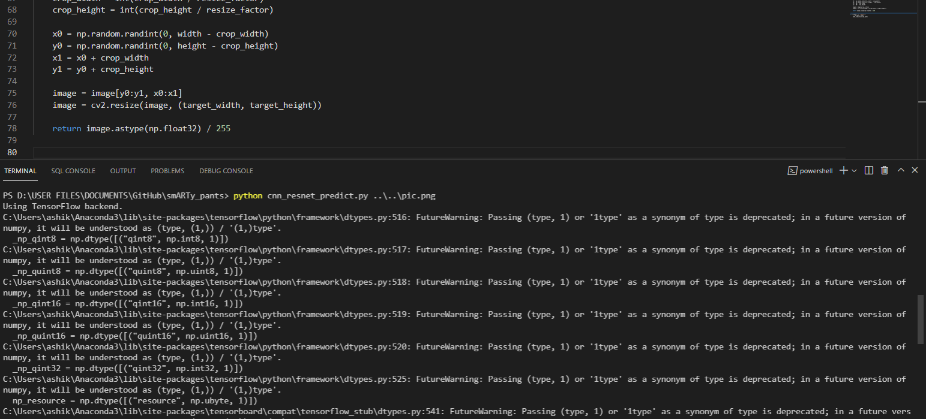
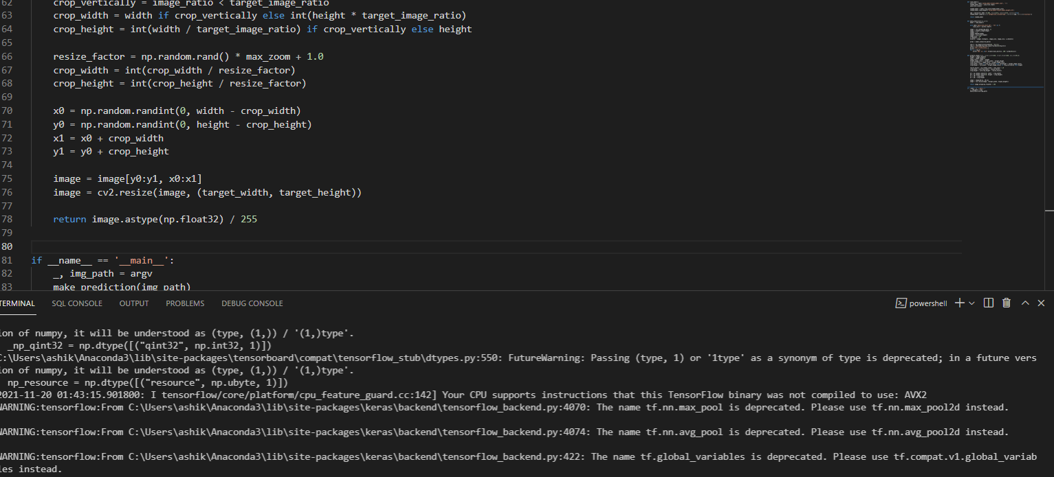
OUTPUT PREDICTION

